Slide 1
Data Communication
ECE 3151
Section B
(2024)

Slide 2
Class Hours
Sunday: 11:20-12:20
Wednesday: 11:20-12:20
Thursday: 11:20-12:20
Recommended Books
1. B. A. Forouzan, “Data Communications and Networking”, 5/e
2. W. Stallings, “Data and Computer Communications”, 10/e
3. B. P. Lathi, “Modern Digital and Analog Communication Systems”, 3/e
4. G. Keiser, “Fiber Optic Communications”, Springer(2021)

Slide 3
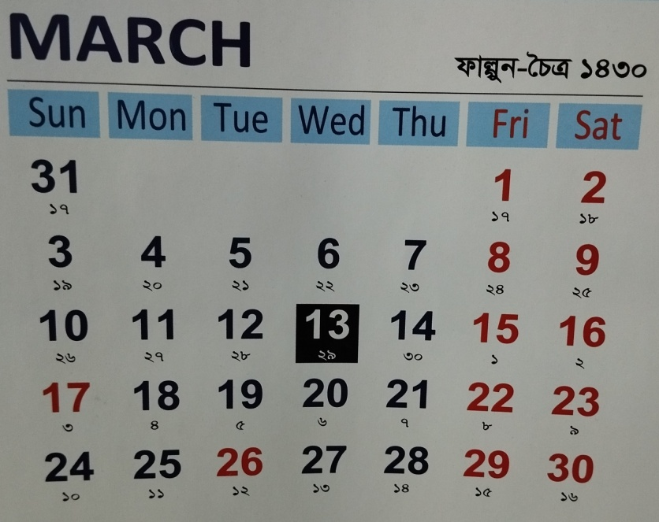
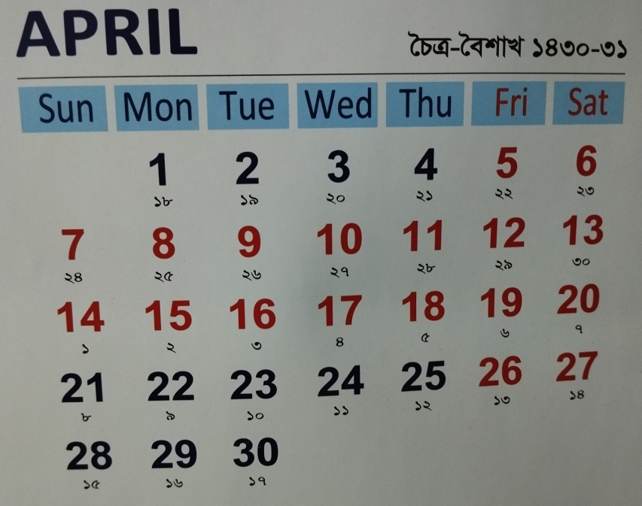
Lecture Plan
Topics to be Covered:
Calculation of detection-error probability (3 hr.)
Transmission impairments and noise (1 hr.)
Concept of channel coding and channel capacity (1 hr.)
Error detection and correction codes (3 hrs.)
Communication medium ( 1 hr.)
Basics of fiber-optic communication systems (3 hrs.)
Assessment:
2 class tests(CT)
(best one will be counted)
CT-1: 20.3.2023
CT-2: 04.04.2023

Slide 4
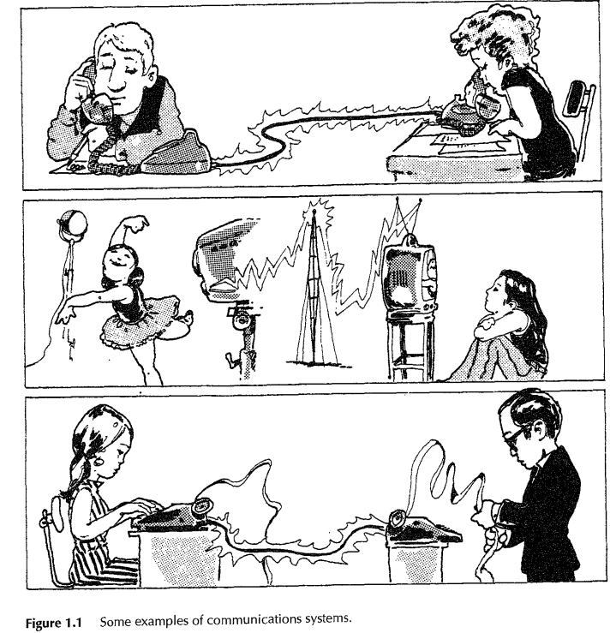
Examples of Communication Systems
Source
Medium
Destination
Human voice
Source originates the message
Medium carries the message
Destination unit receives the message
Television picture
Teletype message/data
Ref. B.P. Lathi,3/e, p.2

Slide 5
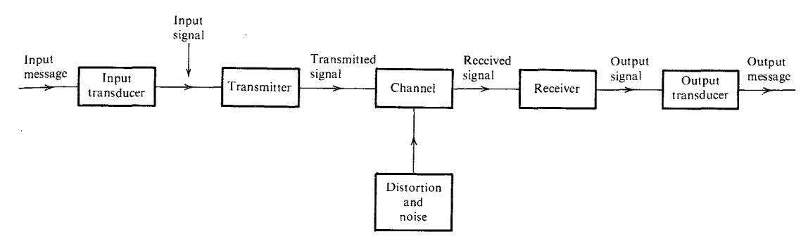
A Typical Communication System
Twisted pair cable, coaxial cable, optical fiber, wireless or radio link.
Source
Medium
Destination
modulation
demodulation
message signal/baseband signal
Calculation of detection-error probability
Channel coding (encoder), before modulation.
Error detection and correction codes
Channel coding (decoder), after demodulation.
Error detection and correction codes
Transmission impairments
SNR(signal-to-noise ratio) =signal power/noise power
Ref. B.P. Lathi,3/e, p.3
Can an amplifier help improving the SNR of a received signal?

Slide 6
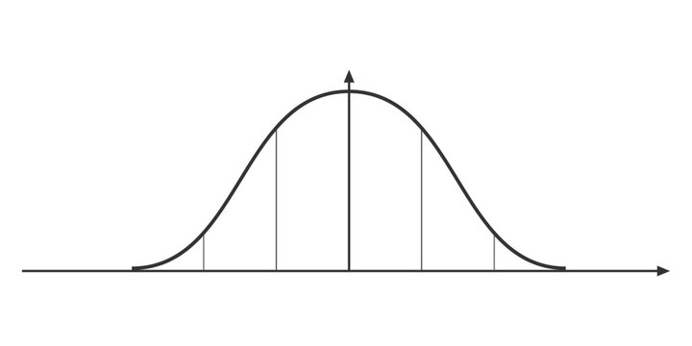
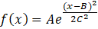
Normal distribution/Gaussian distribution
f(x)
A
C
x
B-C
B
B+C
x= continuous random variable
f(x)= probability density function
A= peak amplitude
B= mean
C= standard deviation
C²= variance

Slide 7
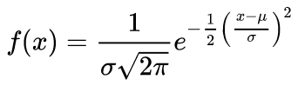
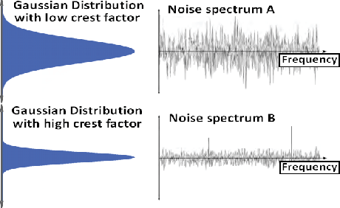
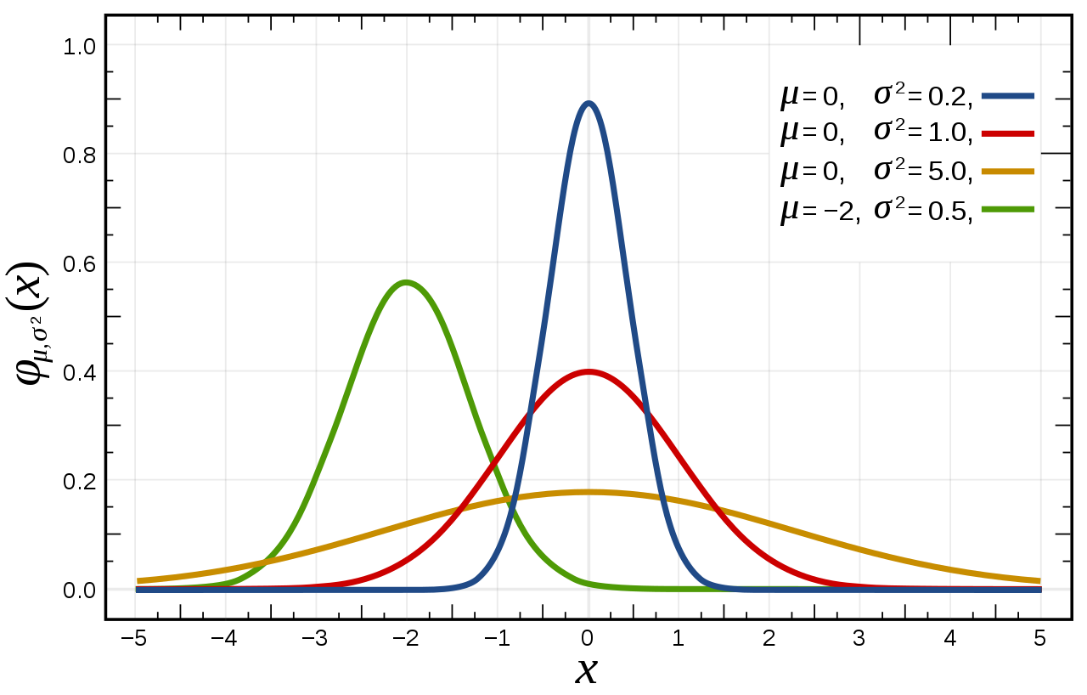
Noise can be modeled by Gaussian distribution
Source: wikipedia
Source: DOI:10.1109/APCC.2012.6388180
Two white noise sources: Spectrum A has a large variance in power distribution, and thus provides a low crest factor. Spectrum B has a high crest factor, so unwanted signal levels are less frequent.
Crest factor=difference between peak and average level of a signal

Slide 8
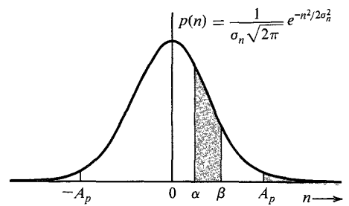
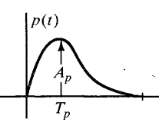
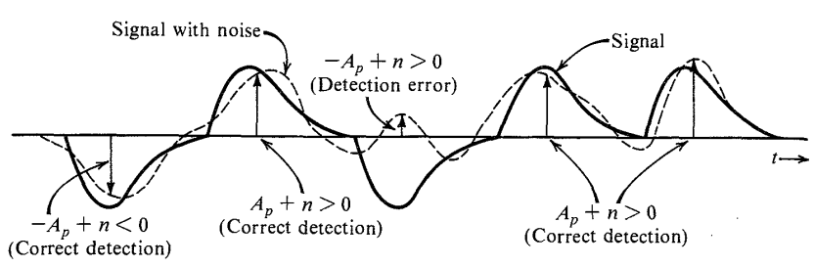
Detection-Error Probability
The signal received at the detector = desired pulse train + a random channel noise
Assume zero ISI (inter-symbol interference)
Let’s consider a polar transmission with a basic pulse p(t)
0|0
1|1
0|1
1|1
1|1
Without noise:
1=A_{p} 0=-A_{p}
With noise the samples would be:
1=A_{p}+n , error occurs if n<-A_{p}
0= -A_{p}+n, error occurs if n>A_{p}
n=random noise amplitude
Ref. B.P. Lathi,3/e, p.330

Slide 9
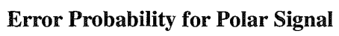
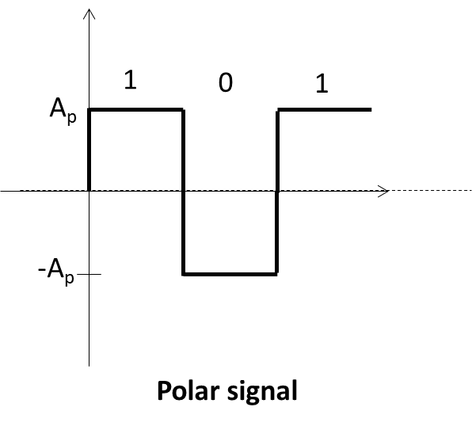
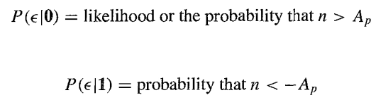

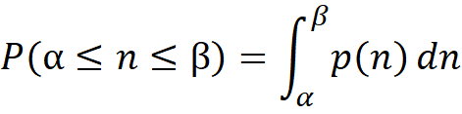
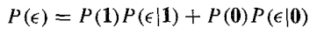
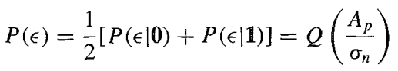
1=A_{p}+n , error occurs if n<-A_{p}
0= -A_{p}+n, error occurs if n>A_{p}
n=random noise amplitude
Decision thresholds
pdf→ probability of a continuous random variable falling within a particular range of values.
Probability density function(pdf) of white noise:
QUIZ: What is pmf?
QUIZ: P(α)=?
P(β)=?, P(A_{p})=?,
P(-A_{p})=?
If 1 and 0 are equally likely:
P(0)=P(1)= 50%
Ref. B.P. Lathi,3/e, p.331

Slide 10
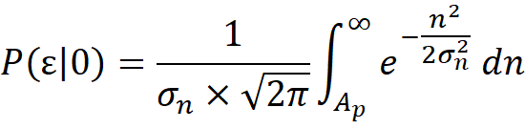
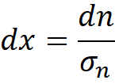
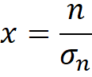
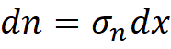
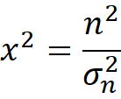
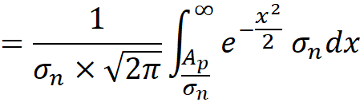
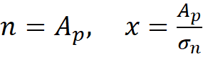
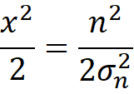
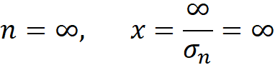
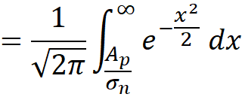
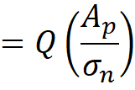
New limit
Q-function:

Slide 11
Binary System: You are sending either 0 or 1
Mutually exclusive events: those events that do not occur simultaneously. e.g., tossing a coin, you get either Head or Tail.
Mutually exclusive events: 2
Mutually exclusive events: 2
Mutually exclusive events: 04
S₀
D₀.S₀
D₁.S₀
D₀
D₁
S₁
D₀.S₁
D₁.S₁
Event S₀: 0 was sent
Event S₁: 1 was sent
Event D₀: 0 is detected
Event D₁: 1 is detected
Event D₀.S₀: 0 sent, 0 detected
Event D₁.S₁: 1 sent, 1 detected
Event D₁.S₀: 0 sent, 1 detected
Event D₀.S₁: 1 sent, 0 detected
P(S₀)+P(S₁)=1
P= probability
P(D₀)+P(D₁)=1
P(bit error)= P(D₀.S₁) + P(D₁.S₀)
From Product rule:
P(D₀|S₁)=P(D₀.S₁)/P(S₁) =>P(D₀.S₁)= P(S₁) P(D₀|S₁)
P(D₁|S₀)=P(D₁.S₀)/P(S₀) =>P(D₁.S₀)= P(S₀) P(D₁|S₀)
P(bit error)= P(S₁) P(D₀|S₁)+P(S₀) P(D₁|S₀)

Slide 12
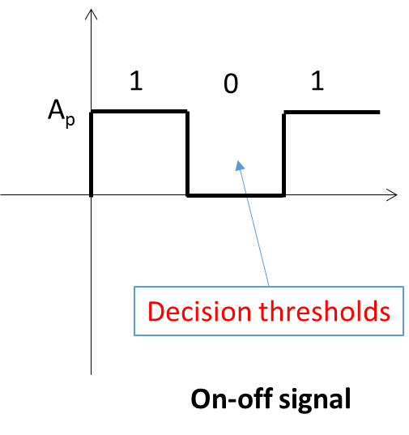
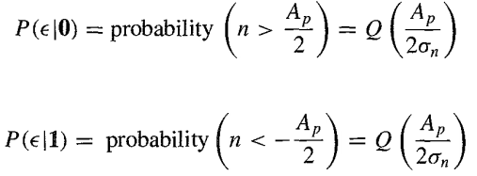
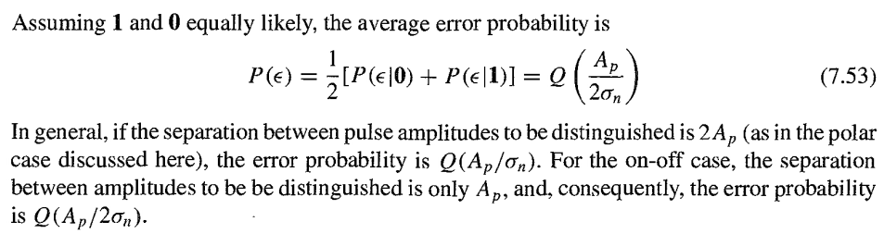
Error probability for on-off signal
A_{p}/2
-A_{p}/2
1
0
1
A_{p}/2
-A_{p}/2
Ref. B.P. Lathi,3/e, p.333

Slide 13
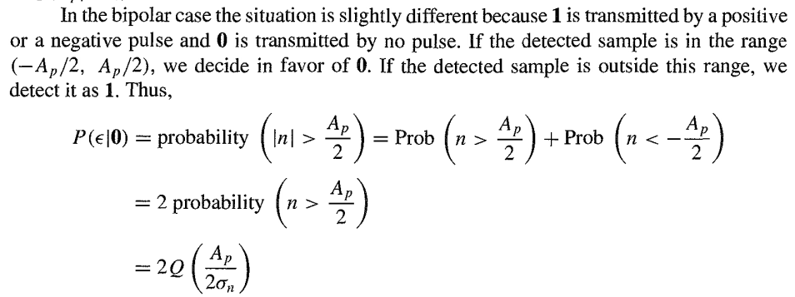
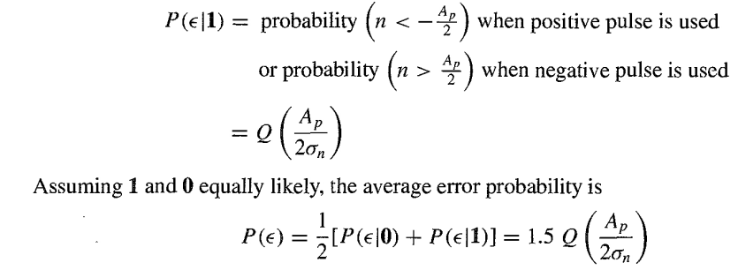
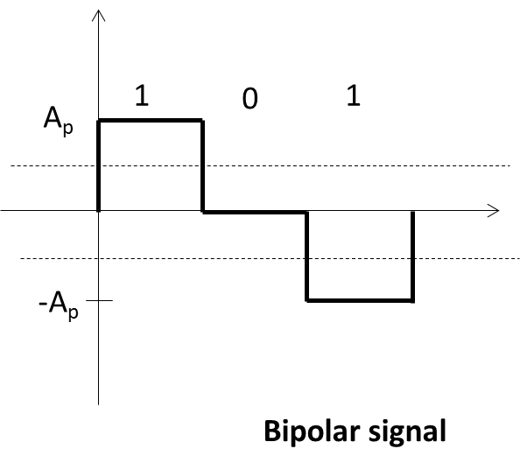
Ref. B.P. Lathi,3/e, p.333
Error probability for Bipolar signal
and
Ap/2
-Ap/2
Decision thresholds

Slide 14
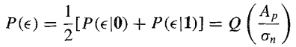
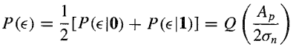
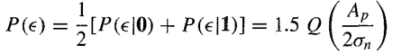
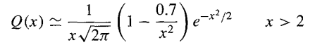
1
0
1
1
0
1
1
0
1
A_{p}
A_{p}
A_{p}
-A_{p}
-A_{p}
Decision thresholds
Polar signal
On-off signal
Bipolar signal

Slide 15
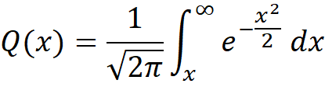
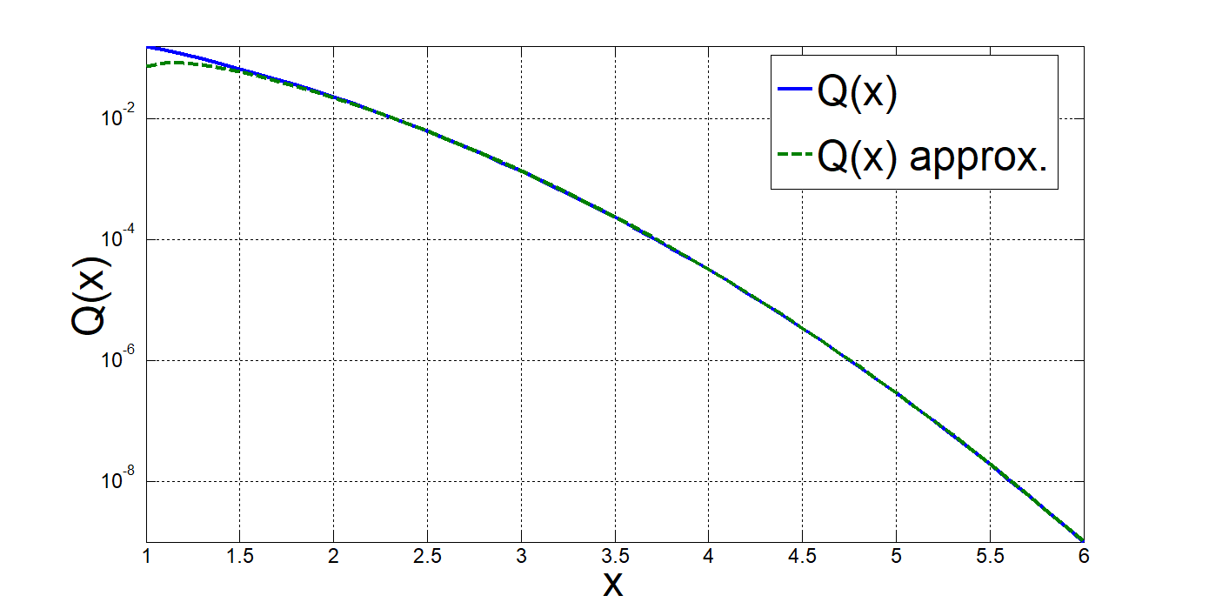
MATLAB Output
x = 1:0.1:6;
y = qfunc(x);
q1=1./(x*sqrt(2*pi));
q2=1-0.7./x.^2;
q3=exp(-x.^2/2);
Q=q1.*q2.*q3;
semilogy(x,y,x,Q)
axis tight;

Slide 16
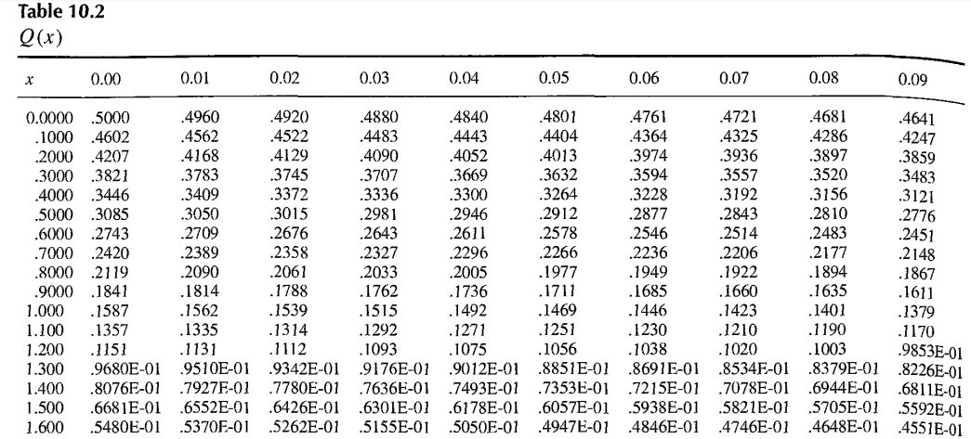
Ref. B.P. Lathi,3/e, p.454

Slide 17
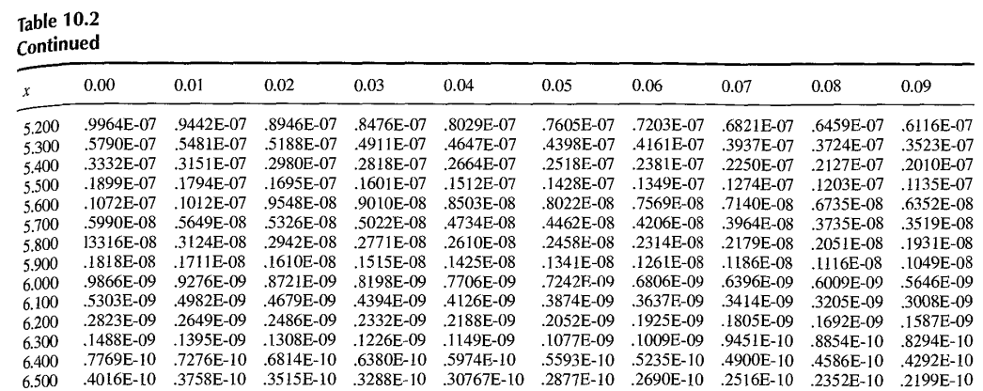
Q(5.36)= 0.4161×10⁻⁷
Q(6.12)= 0.4679×10⁻⁹
Ref. B.P. Lathi,3/e, p.455

Slide 18
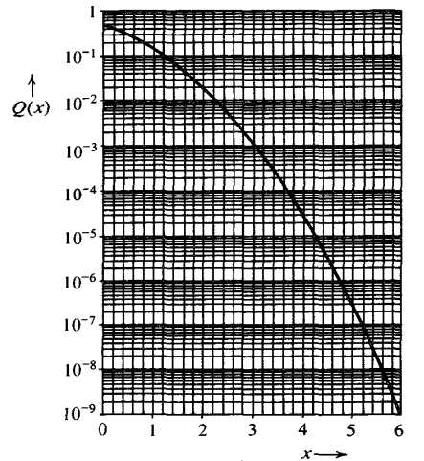
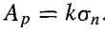
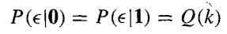
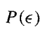
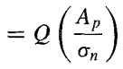
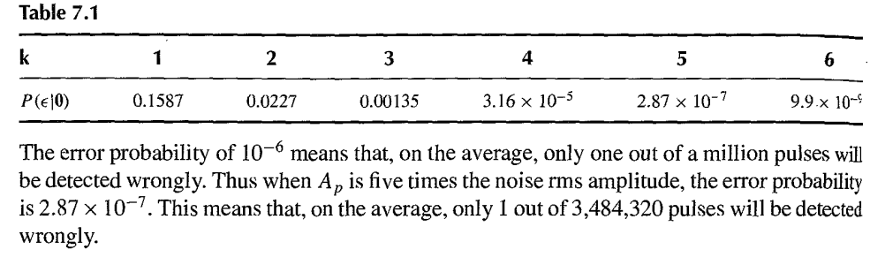
If peak pulse amplitude is k times the noise rms value:
For polar signal
1/ 2.87×10⁻⁷≈3,484,320
Ref. B.P. Lathi,3/e, p.332
Ref. B.P. Lathi,3/e, p.458

Slide 19
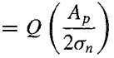








Polar
On-off
Bipolar
It seems that probability of error is 50% higher for Bipolar case than On-off case. This increase in error probability can be compensated by just a little increase in signal power.
To attain
Since
Ref. B.P. Lathi,3/e, p.333
1.5Q(x)=0.286×10⁻⁶
Q(x)=1.9066×10⁻⁷
10.16-10
10
10.16²-10²
10²
x~ 5.08
= 0.016 = 1.6%
,
= 0.03225 = 3.23%
This is just a 1.6% increase in the signal amplitude (or 3.23% increase in signal power) required over the on-off case.

Slide 20

Ref. B.P. Lathi,3/e, p.333

Slide 21


E=A_{p}²
2E=2A_{p}²=(√2A_{p})²
Ref. B.P. Lathi,3/e, p.334

Slide 22

Concept of Frequency, Spectrum, and Bandwidth
Ref. W. Stalling,10/e, p.74

Slide 23


Ref. W. Stalling,10/e, p.75

Slide 24

Ref. W. Stalling,10/e, p.76

Slide 25




f= fundamental frequency, 3f= harmonic frequency
Average amplitude=0, i.e., no dc component
Ref. W. Stalling,10/e, p.78

Slide 26



Fourier Series/Fourier Transform?
Spectrum of periodic signal is discrete
Spectrum of aperiodic signal is continuous
4/π=1.27
4/3π=0.424
s(t)
1
t
-x/2
+x/2
Ref. W. Stalling,10/e, p.79

Slide 27



4/π=1.27
1
Average amplitude ≠ 0, i.e., there is a dc component
4/3π=0.424
Ref. W. Stalling,10/e, p.80

Slide 28



Effective bandwidth?
If the waveform represents the repetitive binary stream 0101.... Then the duration of each pulse is 1/(2f); thus the data rate is 2f bits per second(bps).
0
0
0
The frequency components of the square wave with amplitudes A and -A can be expressed as follows:
T/2=1/2f
1
1
Data rate=2f bps
Fourier series expansion
Ref. W. Stalling,10/e, p.79

Slide 29




Ref. W. Stalling,10/e, p.81

Slide 30








Original signal
MATLAB Output for
k=1 to 1
k=1 to 3
k= 1 to 4
t = 0:0.001:100;
A=4;
f=0.03;
w=2*pi*f;
sum=0;
for k = 1:1000
sum=sum+(sin(w*(2*k-1)*t))/(2*k-1);
end
F1=(4*A/pi)*sum;
plot(t,F1);
grid on;
k=1 to 10
k=1 to 100
k=1 to 1000
Gibbs phenomenon
Zoom in

Slide 31

T=1µs
0.5µs→ 1 bit
1µs→ 1/0.5 bit=2 bit
1s→ 2×10⁶ bits=2Mb
Data rate=2Mbps
Ref. W. Stalling,10/e, p.82

Slide 32

Ref. W. Stalling,10/e, p.82

Slide 33

Any digital waveform has infinite bandwidth. But channel/medium’s bandwidth is finite.
For any given medium, the greater the bandwidth transmitted, the greater the cost.
Therefore, Economic and practical reasons dictate that digital information be approximated by a signal of limited bandwidth.
Negative effect of limiting the signal bandwidth:
limiting the bandwidth creates distortions, which makes the task of interpreting the received signal more difficult.
The more limited the bandwidth, the greater the distortion, and the greater the potential for error by the receiver. i.e., BER will increase. [BER=bit-error rate or probability of bit error]
Ref. W. Stalling,10/e, p.83

Slide 34


Ref. W. Stalling,10/e, p.83
If we want to send data at higher speed, greater bandwidth will be required for transmission.
The greater the bandwidth of a transmission system, the higher the data rate that can be transmitted over that system.
For a data rate of 2 kbps , 2×2=4kHz bandwidth is required for faithful transmissions.
If the noise is not severe, less BW can do the same job.

Slide 35

TRANSMISSION IMPAIRMENT
Signals travel through transmission media, which are not perfect. The imperfection causes signal impairment. This means that the signal at the beginning of the medium is not the same as the signal at the end of the medium. What is sent is not what is received.
Three causes of impairment are attenuation, distortion, and noise.
For digital signals, bit errors may be introduced, such that a binary 1 is transformed into a binary 0 or vice versa due to these impairments.
Ref. B. A. Forouzan,5/e, p.77

Slide 36

Attenuation
Attenuation means a loss of energy.
When a signal travels through a medium, it loses some of its energy in overcoming the resistance of the medium.
E.g., A wire carrying electric signals gets warm after a while. Some of the electrical energy in the signal is converted to heat.
To compensate for this loss, amplifiers are used to amplify the signal.
Ref. B. A. Forouzan,5/e, p.77

Slide 37






Ref. B. A. Forouzan,5/e, p.78
Example 3.26: Suppose a signal travels through a transmission medium and its power is reduced to one-half. This means that P₂ is (1/2)P₁. In this case, the attenuation (loss of power) can be calculated as
Ref. W. Stalling,10/e, p.107
A loss of 3 dB (–3 dB) is equivalent to losing one-half the power.
Example 3.27: A signal travels through an amplifier, and its power is increased 10 times. This means that P₂ = 10P₁ . In this case, the amplification (gain of power) can be calculated as
Ref. W. Stalling,10/e, p.108

Slide 38



L_{dB} = loss, in decibels.
Ref. W. Stalling,10/e, p.108

Slide 39

Ref. W. Stalling,10/e, p.109

Slide 40


Example 3.28: One reason that engineers use the decibel to measure the changes in the strength of a signal is that decibel numbers can be added (or subtracted) when we are measuring several points (cascading) instead of just two. In the following figure a signal travels from point 1 to point 4.
Example 3.29: Sometimes the decibel is used to measure signal power in milliwatts. In this case, it is referred to as dBm and is calculated as dBm = 10 log₁₀ P_{m} , where P_{m} is the power in milliwatts. Calculate the power of a signal with dBm = −30.
dBm=10log₁₀P_{m}=-30
log₁₀P_{m}=-3
P_{m}= 10⁻³ mW
Ref. B. A. Forouzan,5/e, p.78

Slide 41

Example 3.30: The loss in a cable is usually defined in decibels per kilometer (dB/km). If the signal at the beginning of a cable with −0.3 dB/km has a power of 2 mW, what is the power of the signal at 5 km?
The loss in the cable in decibels is 5 × (−0.3) = −1.5 dB. We can calculate the power as
Ref. B. A. Forouzan,4/e, p.83

Slide 42

Distortion
Ref. B. A. Forouzan,5/e, p.79
Distortion means that the signal changes its form or shape.
Distortion can occur in a composite signal made of different frequencies. Each signal component has its own propagation speed through a medium and, therefore, its own delay in arriving at the final destination.
Differences in delay may create a difference in phase if the delay is not exactly the same as the period duration.
In other words, signal components at the receiver have phases different from what they had at the sender. The shape of the composite signal is therefore not the same.

Slide 43

Noise
Undesired signals are referred to as noise. Noise is the major limiting factor in communications system performance. [Ref. W. Stalling, 10/e, P.95]
Ref. B. A. Forouzan,5/e, p.80

Slide 44


[Ref. W. Stalling, 10/e, P.96]

Slide 45


[Ref. W. Stalling, 10/e, P.97]
0 degree Celsius = 273.15 Kelvin, 17 degree Celsius = 273.15+17 ≈ 290 K
10×log(4×10⁻²¹)= -203.98≈ -204
The temperature at which the resistor’s resistance equals the noise power produced by the circuit or device is known as the effective noise temperature.

Slide 46

[Ref. W. Stalling, 10/e, P.97]

Slide 47

[Ref. W. Stalling, 10/e, P.97]

Slide 48

[Ref. W. Stalling, 10/e, P.98]

Slide 49
Example 3.31: The power of a signal is 10 mW and the power of the noise is 1 μW; what are the values of SNR and SNR_{dB} ?
10 mW=10,000 µW
SNR(signal-to-noise ratio)
=signal power/noise power
µ
Example 3.32: The values of SNR and SNR_{dB} for a noiseless channel are:
We can never achieve this ratio in real life; it is an ideal.
Ref. B. A. Forouzan,4/e, p.84

Slide 50

Two cases of SNR: a high SNR and a low SNR
QUIZ: Can an amplifier improve the SNR?
Ref. B. A. Forouzan,4/e, p.85

Slide 51


Channel Capacity/Data Rate Limits
Noiseless Channel: Nyquist Bit Rate Noisy Channel: Shannon Capacity
A very important consideration in data communications is how fast we can send data, in bits per second, over a channel. Data rate depends on three factors:
1. The bandwidth available
2. The level of the signals we use
3. The quality of the channel (the level of noise)
Harry Nyquist
(1889-1976), a Swedish physicist and electronic engineer.
BW, signal power, noise power
The maximum rate at which data can be transmitted over a given communication path, or channel, under given conditions, is referred to as the channel capacity.
Ref: [Wikipedia]
Claude Elwood Shannon (1916-2001) an American mathematician, electrical engineer, and cryptographer, also known as a "father of information theory”.
Ref. B. A. Forouzan,4/e, p.85

Slide 52

Noiseless Channel: Nyquist Bit Rate
With multilevel signaling, the Nyquist formulation becomes
where M is the number of discrete signal or voltage levels.
[Ref. W. Stalling, 10/e, P.98]
=Theoretical maximum bit rate(i.e., channel capacity)
[Unit: bps]
This limitation is due to the effect of intersymbol interference, such as is produced by delay distortion.
For a given bandwidth, the data rate can be increased by increasing the signal levels. However, this places an increased burden on the receiver: Instead of distinguishing one of two possible signal levels during each signal time, it must distinguish one of M possible signal levels.
If the number of levels in a signal is just 2, the receiver can easily distinguish between a 0 and a 1. If the level of a signal is 64, the receiver must be very sophisticated to distinguish between 64 different levels.
Increasing the levels of a signal may reduce the reliability of the system.

Slide 53

Two digital signals: one with 2 signal levels and the other with 4 signal levels
Bit rate=Baud rate= 8bps
M=2
Baud rate= number of signal units per second
Bit rate= number of bits per second
Baud rate= 8bps
M=4
Ref. B. A. Forouzan,4/e, p.72

Slide 54

QUIZ
M=?
M=?
Source: https://elec2pcb.com/2022/04/19/su-khac-biet-giua-toc-do-bit-bit-rate-va-toc-do-truyen-baud-rate/

Slide 55

Example 3.34: Consider a noiseless channel with a bandwidth of 3000 Hz transmitting a signal with two signal levels. The maximum bit rate can be calculated as
Example 3.35: Consider the same noiseless channel transmitting a signal with four signal levels (for each level, we send 2 bits). The maximum bit rate can be calculated as
Ref. B. A. Forouzan,4/e, p.86
[Ref. W. Stalling, 10/e, P.98]

Slide 56
Example 3.36: We need to send 265 kbps over a noiseless channel with a bandwidth of 20 kHz. How many signal levels do we need?
L = M
Since this result is not a power of 2, we need to either increase the number of levels or reduce the bit rate. If we have 128 levels, the bit rate is 280 kbps. If we have 64 levels, the bit rate is 240 kbps.
Note: 280 kbps vs. 240 kbps. Not much degradation. So 64 levels can be a cost-effective solution for this case to avoid receiver complexity.
Ref. B. A. Forouzan,4/e, p.86

Slide 57

Noisy Channel: Shannon Capacity Formula
Nyquist’s formula indicates that, all other things being equal, doubling the bandwidth doubles the data rate. Now consider the relationship among data rate, noise, and error rate. The presence of noise can corrupt one or more bits. If the data rate is increased, then the bits become “shorter” so that more bits are affected by a given pattern of noise.
All of these concepts can be tied together neatly in a formula developed by the mathematician Claude Shannon. As we have just illustrated, the higher the data rate, the more damage that unwanted noise can do. For a given level of noise, we would expect that a greater signal strength would improve the ability to receive data correctly in the presence of noise.
Shannon’s result is that the maximum channel capacity, in bits per second, obeys the equation
where C is the capacity of the channel in bits per second and B is the bandwidth of the channel in hertz. The Shannon formula represents the theoretical maximum that can be achieved.
[Ref. W. Stalling, 10/e, P.99]

Slide 58
In practice, however, only much lower rates are achieved. One reason for this is that the formula assumes white noise (thermal noise). Impulse noise is not accounted for, nor are attenuation distortion and delay distortion. Even in an ideal white noise environment, present technology still cannot achieve Shannon capacity due to encoding issues, such as coding length and complexity.
The capacity indicated in the preceding equation is referred to as the error-free capacity. Shannon proved that if the actual information rate on a channel is less than the error-free capacity, then it is theoretically possible to use a suitable signal code to achieve error-free transmission through the channel. Shannon’s theorem unfortunately does not suggest a means for finding such codes, but it does provide a yardstick by which the performance of practical communication schemes may be measured.
We define the spectral efficiency, also called bandwidth efficiency, of a digital transmission as the number of bits per second of data that can be supported by each hertz of bandwidth. The theoretical maximum spectral efficiency can be expressed in C/B = log(base₂₎(1 + SNR). C/B has the dimensions bps/Hz. At SNR = 1, we have C/B = 1.
[Ref. W. Stalling, 10/e, P.100]

Slide 59
SNR=signal power/noise power
For a given level of noise, it would appear that the data rate could be increased by increasing either signal strength or bandwidth. However, as the signal strength increases, the effects of nonlinearities in the system also increase, leading to an increase in intermodulation noise. Note also that, because noise is assumed to be white, the wider the bandwidth, the more noise is admitted to the system. Thus, as B increases, SNR decreases.
[Ref. W. Stalling, 10/e, P.101]

Slide 60

[Ref. W. Stalling, 10/e, P.102]

Slide 61
Example 3.37: Consider an extremely noisy channel in which the value of the signal-to-noise ratio is almost zero. In other words, the noise is so strong that the signal is faint. For this channel the capacity C is calculated as
This means that the capacity of this channel is zero regardless of the bandwidth. In other words, we cannot receive any data through this channel.
Example 3.38: We can calculate the theoretical highest bit rate of a regular telephone line. A telephone line normally has a bandwidth of 3000 Hz. The signal-to-noise ratio is usually 3162. For this channel the capacity is calculated as
This means that the highest bit rate for a telephone line is 34.860 kbps. If we want to send data faster than this, we can either increase the bandwidth of the line or improve the signal-to-noise ratio.
Ref. B. A. Forouzan,4/e, p.87

Slide 62





Example 3.39: The signal-to-noise ratio is often given in decibels. Assume that SNR_{dB} = 36 and the channel bandwidth is 2 MHz. The theoretical channel capacity can be calculated as
Example 3.40: For practical purposes, when the SNR is very high, we can assume that SNR + 1 is almost the same as SNR. In these cases, the theoretical channel capacity can be simplified to
=$\frac{\log_{10}(SNR)}{\log_{10}(2)}=\frac{{10×log}_{10}(SNR)}{{10×log}_{10}(2)}=\frac{{SNR}_{dB}}{3}$
$$\log_{2}\left(1+SNR\right)\sim \log_{2}\left(SNR\right)$$
For example, we can calculate the theoretical capacity of the previous example as
Ref. B. A. Forouzan,4/e, p.88

Slide 63

Example 3.41: We have a channel with a 1-MHz bandwidth. The SNR for this channel is 63. What are the appropriate bit rate and signal level?
The Shannon formula gives us 6 Mbps, the upper limit. For better performance we choose something lower, 4 Mbps, for example. Then we use the Nyquist formula to find the number of signal levels.
Ref. B. A. Forouzan,4/e, p.88
The Shannon capacity gives us the upper limit; the Nyquist formula tells us how many signal levels we need.
Sample Question

Slide 64


Ref. B. P. Lathi,3/e, p.711

Slide 65



1.44S/N_{o}
C
N_{o}B/S
bps
Capacity can be made infinite only by increasing the signal power to infinity which is not practical.
Ref. B. P. Lathi,3/e, p.712

Slide 66





Sample Question
by/to?
Solution:
B=4000Hz, S₁/N₁=7, N_{o}=noise power spectral density, N₁=N_{o}B=noise power, N₂=NoB/4
Reduced by = figure by how much.
Reduced to = resultant figure.
e.g., 10-2=8.
Here, 10 is reduced by 2 and the resultant is reduced to 8.
Therefore, as per the given solution, the concerned term for this problem should be ‘reduced to 25%.’
=12000 bps
(Ans.)

Slide 67

Ref. B. A. Forouzan,4/e, p.89-90
In networking, we use the term bandwidth in two contexts.
The first, bandwidth in hertz, refers to the range of frequencies in a composite signal or the range of frequencies that a channel can pass.
The second, bandwidth in bits per second, refers to the speed of bit transmission in a channel or link.
Example 3.44: A network with bandwidth of 10 Mbps can pass only an average of 12,000 frames per minute with each frame carrying an average of 10,000 bits. What is the throughput of this network?
The throughput is almost one-fifth of the bandwidth in this case.
Bandwidth vs Data rate vs Throughput
Say, Bandwidth of a channel = 5 MHz
Channel capacity (maximum data rate)=10 Mbps (assume a noise free channel and 2 level signaling scheme).
But what we receive exactly is 6 Mbps due to any reason, so the throughput is 6 Mbps.

Slide 68

What is Channel Coding?
Channel coding is a process of detecting and correcting bit errors in digital communication systems.
The conceptual block diagram of a modern wireless communication system is shown below, where the channel coding block is shown in the inset of the dotted block.
Data compression
Transmit antenna
Data decompression
[Ref.] Saleh Faruque, “Radio Frequency Channel Coding Made Easy”, (2016), p.2

Slide 69
At the transmit side, channel coding is referred to as encoder, where redundant bits (parity bits) are added with the raw data before modulation.
At the receive side, channel coding is referred to as the decoder. This enables the receiver to detect and correct errors, if they occur during transmission due to noise, interference and fading*.
*fading is the variation of the attenuation of a signal with various variables such as multipath propagation, rain, and shadowing from obstacles affecting the wave propagation.
Since error control coding adds extra bits to detect and correct errors, transmission of coded information requires more bandwidth.
[Ref.] Saleh Faruque, “Radio Frequency Channel Coding Made Easy”, (2016), p.2

Slide 70
As the size and speed of digital data networks continue to expand, bandwidth efficiency becomes increasingly important. This is especially true for broadband communication, where the digital signal processing is done keeping in mind the available bandwidth resources.
Channel coding forms a very important preprocessing step in the transmission of digital data (bit-stream).
Since bandwidth is scarce and therefore expensive, a coding technique that requires fewer redundant bits without sacrificing error performance is highly desirable.
[Ref.] Saleh Faruque, “Radio Frequency Channel Coding Made Easy”, (2016), p.2

Slide 71
Types of Channel Coding
Channel coding attempts to utilize redundancy to minimize the effect of various channel impairments, such as noise and fading, and therefore increase the performance of the communication system.
There are two basic ways of implementing redundancy to control errors:
(1) Automatic repeat request (ARQ)
(2) Forward error control coding (FECC), or Forward error correction (FEC)
[Ref.] Saleh Faruque, “Radio Frequency Channel Coding Made Easy”, (2016), p.3

Slide 72

ARQ Technique
[Ref.] Saleh Faruque, “Radio Frequency Channel Coding Made Easy”, (2016), p.3

Slide 73
ARQ Technique
The ARQ technique adds parity, or redundant bits, to the transmitted data stream that are used by the decoder to detect an error in the received data. When the receiver detects an error, it requests that the data be retransmitted by the receiver. This continues until the message is received correctly.
In ARQ, the receiver does not attempt to correct the error, but rather it sends an alert to the transmitter in order to inform it that an error was detected and a retransmission is needed. This is known as a negative acknowledgement (NAK), and the transmitter retransmits the message upon receipt. If the message is error-free, the receiver sends an acknowledgement (ACK) to the transmitter.
This form of error control is only capable of detecting errors; it has no ability to correct errors that have been detected.
[Ref.] Saleh Faruque, “Radio Frequency Channel Coding Made Easy”, (2016), p.3

Slide 74
FECC Technique or FEC
In a system which utilizes FECC or FEC coding, the data are encoded with the redundant bits to allow the receiver to not only detect errors, but to correct them as well.
In this system, a sequence of data signals is transformed into a longer sequence that contains enough redundancy to protect the data. This type of error control is also classified as channel coding, because these methods are often used to correct errors that are caused by channel noise.
The goal of all FECC techniques is to detect and correct as many errors as possible without greatly increasing the data rate or the bandwidth.

Slide 75
Application: ARQ vs FEC
The choice of ARQ or FEC depends on the particular application.
ARQ is often used where there is a full-duplex (2-way) channel because it is relatively inexpensive to implement.
FEC is used where the channel is not full-duplex or where ARQ is not desirable because real time is required.

Slide 76
Types of Channel Codes
There are two main categories of channel codes:
Block codes
Convolutional codes.
Block codes accept a block of k information bits and produce a block of n coded bits. By predetermined rules, n-k redundant bits are added to the k information bits to form the n coded bits. Commonly, these codes are referred to as (n,k) block codes. k/n is known as code rate or code efficiency.
Example: Hamming Codes and Cyclic Codes
Convolutional codes convert the entire data stream into one single codeword. The encoded bits n depend not only on the current k information bits but also on the previous information bits.
Example: Turbo codes

Slide 77
Choice of Channel Codes
The choice of a channel coding scheme for a particular application is a trade-off between various factors:
Code rate (the ratio between the number of information symbols and the number of code symbols)
Reliability (the bit or message error probability)
Complexity (the number of calculations required to perform the encoding and decoding operations).
Shannon showed in his landmark paper (1948) that virtually error-free communication is possible at any rate below the channel capacity. However, his result did not include explicit constructions and allowed for infinite bandwidth and complexity.
Hence, ever since 1948, scientists and engineers have been working to further develop coding theory and to find practically implementable coding schemes.
The introduction of turbo codes in 1993 caused a true revolution in error control coding. These codes allow transmission rates that closely approach channel capacity.
[Ref. ] A book chapter on channel coding,
can be downloaded from https://www.researchgate.net/publication/353917144_Channel_coding

